Slide 1
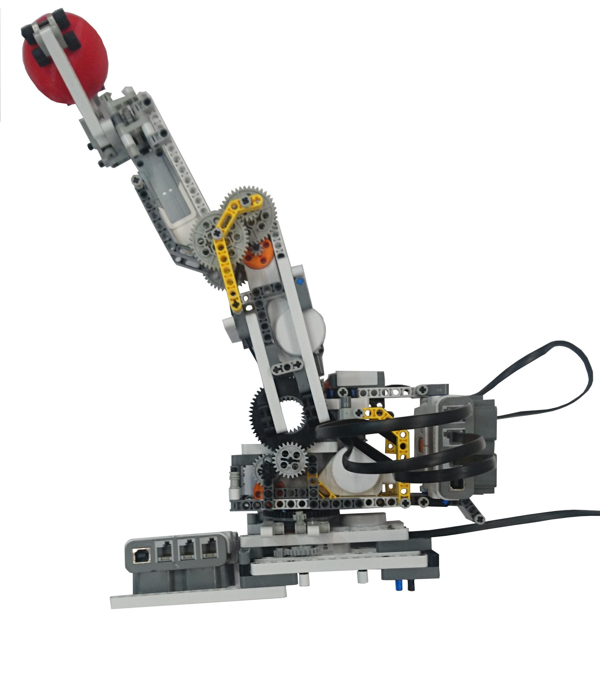
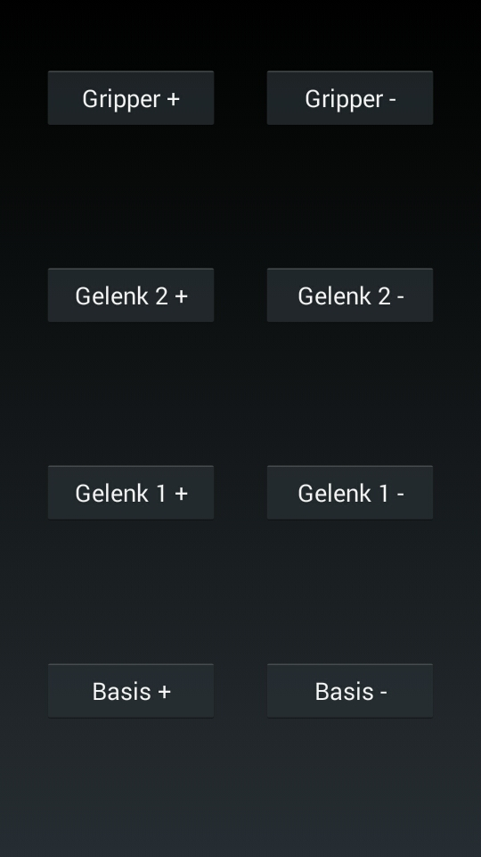
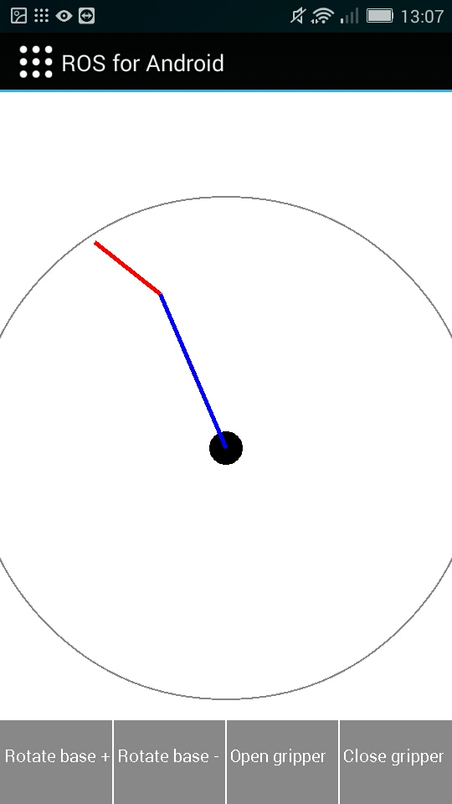

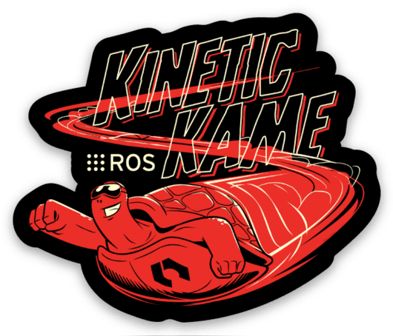

App-controlled LEGO robotic arm
Project of lecture „Mobile Computing“ (winter term 2018/2019)
Christoph Ulrich
Benjamin Schaefer
christoph.ulrich
benjamin.schaefer@htwg-konstanz.de
Three Degrees of Freedom
Easily expandable (by means of extra sensors or similar)
Can lift about 150 gr. in the extended state (about 3/4 of its own weight)
Arm without base weighs ~200 gr.
High repeatability of +/- 1 degree
Regulation of the arm via ROS ActionServer
Joints and gripper individually controlled via buttons
Definition of the target pose of the „Tool Center Point“
Forward and inverse kinematics
Communication with the arm via ROS

